Slide 1
CSS3 Transformations and Animations
Notes:
One of the most powerful new features in CSS3 is the ability to define transformations and animations for elements. Transformations include things like rotations, scaling operations, and translations. Animations allow you to change an element's property to a new value over a specified timeframe.

Slide 2
Contents
Transitions
Transformations
Keyframe animations
Demos folder for this chapter:
Demos\07-TransAni
Notes:
Section 1 introduces the concept of transitions, which allow you to indicate that a property value change should occur over a specified timeframe, rather than happen immediately.
Section2 shows how to implement transformations in CSS3. we'll show how to rotate elements, scale them, translate them, skew them, etc.
Section 3 discusses keyframe animations, where you can specify a discrete set of values for properties over a specified timespan.

Slide 3
1. Transitions
Overview of transitions
Defining multiple transitions
Setting detailed transition properties
Handling transition events
Notes:
CSS3 transitions allow you to specify smooth transitions for property values, from whatever their current value is, to whatever their target value is.
Transitions don't really care about the values themselves, but on how long it takes to change from one value to the other.

Slide 4
Overview of Transitions
CSS3 allows you to define transitions for property changes
E.g. when a user hovers over an element…
… increase the width over a period of 3 seconds
To define a transition
Set the transition property
Specify the property to vary, and the time span
Example (e.g. in IE11)
See Transitions/SimpleTransition.html
#myPanel {
width: 200px;
transition: width 3s;
}
#myPanel:hover {
width: 300px;
}
Notes:
The example in the slide shows simple usage of the transition property.
In this example, we've defined a transition on the width property for #myPanel, so that whenever the width changes, it will take 3 seconds for this change to happen.

Slide 5
Defining Multiple Transitions
The transition property can specify multiple transitions
Specify a comma separated list of property names and durations
Example (e.g. in IE11)
See Transitions/MultipleTransitions.html
#myPanel {
background-color: orange;
width: 200px;
height: 100px;
transition: background-color 4250ms, width 1s, height 1s;
}
#myPanel:hover {
background-color: yellow;
width: 300px;
height: 150px;
}
Notes:
This example takes things a step further. Now, we've defined multiple transitions for #myPanel:
The background-color property will take 4250ms to change.
The width and height properties will take 1 second to change.

Slide 6
Setting Detailed Transition Properties
There are several detailed properties that you can set, to control every aspect of a transition…
transition-property
transition-duration
transition-timing-function
transition-delay
transition (shorthand property for the 4 properties above)
Example (e.g. in IE11)
See Transitions/DetailedTransition.html
Notes:
For full control over transitions, you can use the specific transition-related properties listed in the slide.
The demo shows how to use these properties. Here's a snippet:
#myPanel {
transition-property: width, height, background-color;
transition-duration: 1s, 1s, 5s;
transition-timing-function: ease-in-out;
transition-delay: 0s, 0s, 1s;
}
This rule specifies the following transitions:
The width property will take 1s to happen, will use the ease-in-out timing function, and will have a 0s delay.
The height property will also take 1s to happen, will use the ease-in-out timing function, and will have a 0s delay.
The background-color property will take 5s to happen, will use the ease-in-out timing function, and will have a 1s delay.

Slide 7
Handling Transition Events
When a transition ends, a transitionend event occurs on the target element
Allows you to do something when the transition is complete, such as playing an animation
The following example shows how to handle this event
Note the properties available on the event object
anElement.addEventListener("transitionend", onTransitionend, true);
…
function onTransitionend(e) {
alert(e.propertyName + " completed after elapsedTime " + e.elapsedTime);
}
Notes:
A transitionend event occurs when a transition has ended. You can handle this event if you want to, as shown in the slide. You probably won't need to do this very often, but it's good to have the option ☺.

Slide 8
2. Transforms
Overview
Translations
Scaling
Rotations
Skewing
Viewing a sample styled document
3D transforms
Notes:
In this section we're going to see how to use CSS3 to transform elements. We'll see how to translate an element to a new x/y location, scale it to make it bigger or smaller, rotate it, and skew it. We'll also show how to perform 3-dimensional transformations.

Slide 9
Overview
CSS3 supports 2D transforms (and 3D - see later)
Enables elements rendered by CSS to be transformed in 2D space
Most browsers use vendor prefixes for these properties, for example:
Apply a series of transformation functions to an element
E.g. matrix, translate, scale, rotate, skew
transform: transformation-functions;
Establish transformation origin (default is element center)
horiz-pos can be length, percentage, or left/center/right
vert-pos can be length, percentage, or top/center /bottom
transform-origin: horiz-pos vert-pos;
-ms-transform: translate(5px);
-webkit-transform: translate(5px);
-moz-transform: translate(5px);
-o-transform: translate(5px);
Notes:
To transform an element, use the CSS3 transform property. You set this property to the transformation function you want to apply (e.g. rotate). We'll show how to do this on the next slide.
CSS3 also has a transform-origin property, which allows you to specify the origin of a transformation. This is relevant for rotations, for example.

Slide 10
Translations (1 of 2)
To translate an element, use one of these functions:
tx
Horizontal translation to the left (-ve) or right (+ve)
Can be a length or a percentage
ty
Vertical translation up (-ve) or down (+ve)
Can be a length or a percentage
If omitted in translate(), the value is 0
translate(tx, [ty])
translateX(tx)
translateY(ty)
Notes:
The translate family of transformation functions allow you to translate an element horizontally and/or vertically. Here's a simple example of usage:
transform: translate(60px);
The following slide shows a complete example.

Slide 11
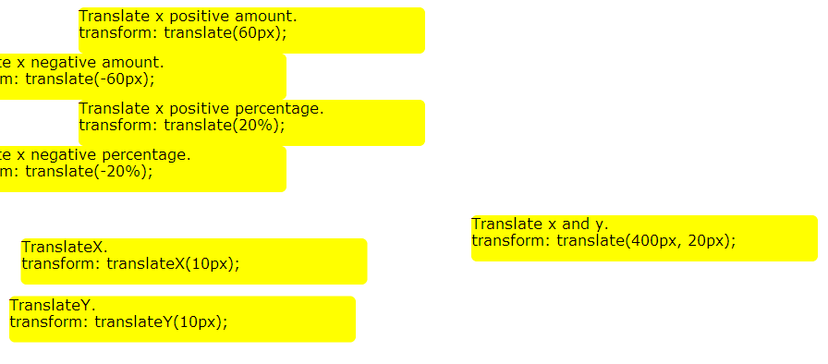
Translations (2 of 2)
Examples
See Transforms\Translations.html
Notes:
This slide illustrates various ways to translate an element, be it horizontally or vertically, left or right, up or down, or by a fixed amount or a percentage of the element's size.

Slide 12
Scaling (1 of 2)
To scale an element, use one of these functions:
sx
Horizontal scaling factor (1.0 = normal scale)
sy
Vertical scaling factor (1.0 = normal scale)
If omitted in scale(), value is same as sx
scale(sx, [sy])
scaleX(sx)
scaleY(sy)
Notes:
The scale family of transformation functions allow you to scale an element to make it bigger or smaller. Here's a simple example of usage:
transform: scale(0.75);
The following slide shows a complete example.

Slide 13
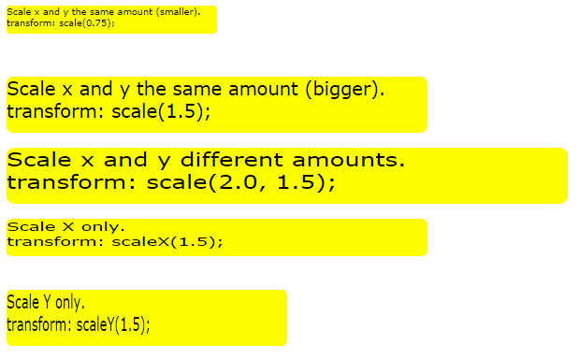
Scaling (2 of 2)
Examples
See Transforms\Scaling.html
Note:
These examples set the transformation origin to be top-left
Notes:
This slide illustrates various ways to scale an element. You can make the element bigger or smaller, depending on whether the scale factor is greater than 1 or less than 1.
You can also scale by different factors in the X and Y axes if you want to. This creates a stretched effect, as shown by the bottom three boxes in the example.

Slide 14
Rotations (1 of 2)
To rotate an element, use this function:
angle
Rotation angle clockwise (+ve) or anticlockwise (-ve)
Can be degrees or radians
rotate(angle)
Notes:
The rotate function allows you to rotate an clockwise or anticlockwise, by the specified angle in degrees or radians Here's a simple example of usage:
transform: rotate(10deg);
The following slide shows a complete example.

Slide 15
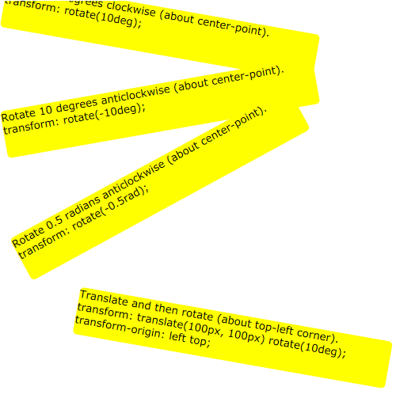
Rotations (2 of 2)
Examples
See Transforms\Rotations.html
Notes:
This slide illustrates various ways to rotate an element. The text in each box explains what's happening in each case.

Slide 16
Skewing (1 of 2)
To skew an element, use one of these functions:
ax
Skew angle about X axis, clockwise (-ve) or anticlockwise (+ve)
Can be degrees or radians
ay
Skew angle about Y axis, clockwise (-ve) or anticlockwise (+ve)
Can be degrees or radians
If omitted in skew(), the value is 0
skew(ax, [ay])
skewX(ax)
skewY(ay)
Notes:
The skew family of transformation functions allow you to skew an element, to make it slant horizontally or vertically. Here's a simple example of usage:
transform: skew(30deg);
The following slide shows a complete example.

Slide 17
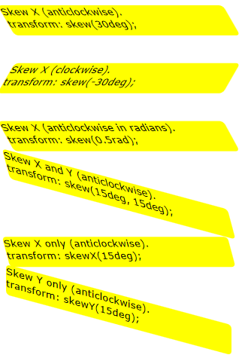
Skewing (2 of 2)
Examples
See Transforms\Skewing.html
Notes:
This slide illustrates various ways to skew an element. The text in each box explains what's happening in each case. Skewing can look slightly odd, so we suggest you use it in moderation.

Slide 18
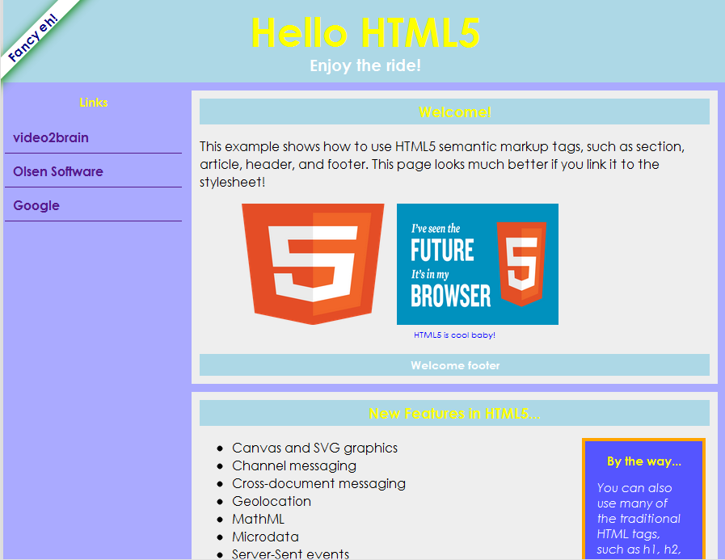
Viewing a Styled Sample Document
Document illustrating CSS3 styles
See MyDocumentWithStyles.html
Notes:
This example shows transformations in action. Note the label in the top-left corner is rotated 45 degrees and positioned absolutely in the top-left corner. This is actually an <h4> element with the following CSS rules:
h4 {
text-align: center;
box-shadow: 2px 2px 20px Green;
transform: rotate(-45deg);
position: absolute;
top: 20px;
left: -150px;
…
}

Slide 19
3D Transforms
CSS3 provides various 3D transformation functions
You must also set a perspective
Use the perspective() function
Or specify perspective and perspective-origin properties
Example (e.g. in IE11)
See Transforms/3DTransformations.html
translate3d(tx, [ty], [tz])
translateZ(tz)
scale3d(sx, [sy], [sz])
scaleZ(sz)
rotate3d(xnum, ynum, znum, angle)
rotateZ(anglee)
Notes:
CSS3 allows 3D transformations, via the additional properties described in the slide. To see 3D transformations in action, open 3DTransformations.html in Internet Explorer.

Slide 20
3. Keyframe Animations
Defining a simple keyframe animation
Applying a keyframe animation
Triggering a keyframe animation
Example
Notes:
CSS3 enables you to define keyframe animations. A keyframe animation is a series of rule-sets that specify property values at distinct stages of the animation. This allows you to implement complex UI effects, which previously would have required video, Flash, etc.

Slide 21
Defining a Keyframe Animation
Here's a simple example of a keyframe animation
Illustrates syntax and helps you to understand the concepts
@keyframes myAnimation {
0% {
left: 0px;
top: 0px;
background-color: red;
}
33% {
left: 100px;
top: 160px;
}
66% {
left: 200px;
top: 0px;
}
100% {
left: 300px;
top: 160px;
background-color: green;
}
}
Notes:
If you want to use keyframe animations, the first step is to define a timeline as shown in the slide. This specifies the values for various properties, at specific times when the keyframe animation is played out.
Note that we haven't specified the target element here, nor the absolute timespan involved. You do this elsewhere…

Slide 22
Applying a Keyframe Animation
To apply a keyframe animation to an element:
Set the animation-name property in a CSS style rule, to the name of a keyframe animation
Example
This CSS rule applies to an element whose id is someElement, when its class is animationOn
Note, there's nothing special about a class named animationOn - you'll see how it all fits together on the next slide ☺
#someElement.animationOn {
animation-name: myAnimation;
}
Notes:
In order for a keyframe animation to actually happen, you must set the animation-name CSS3 property for a target element.
The example in the slide indicates myAnimation should be applied to #someElement when the animationOn CSS class is applied to the element. Note there's nothing magic about the animationOn class - it's just a CSS class name we've happened to invent for this example.

Slide 23
Triggering a Keyframe Animation
To trigger a keyframe animation on an element:
Write some JavaScript code that applies the appropriate CSS class in response to some user action
Example
This JavaScript function is triggered in response to some user action, such as a button-click, mouse-over, etc.
The function applies the animationOn class to the target element, which will trigger the animation!
function startFunctionTriggeredBySomeUserAction() {
var elem = document.getElementById("someElem");
elem.classList.add("animationOn");
}
Notes:
This slide shows how to apply our made-up CSS class animationOn to an element, in response to some user action (e.g. hovering over the element with a mouse).
As soon as this class is applied, it will cause the animation to run on our target element (as per the previous slide).

Slide 24
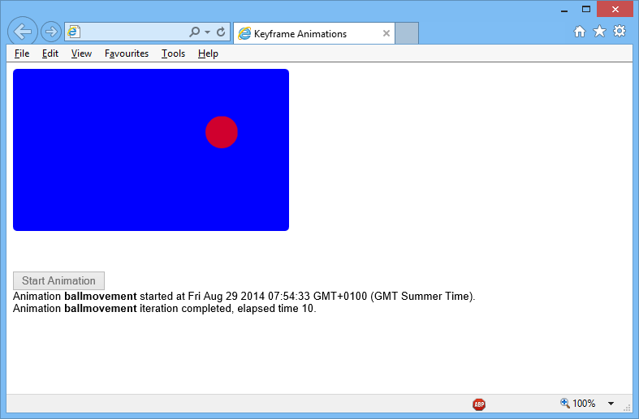
Example
For a complete example of keyframe animations…
See KeyframeAnimations/Pool.html
This example works in IE11
Notes:
The demo in the slide shows a complete example of keyframe animations.

Slide 25
Any Questions?

